Slide 1
Power Bi Desktop
Getting Started…

Slide 2




Hello!
Akshata Revankar
Lead Data Architect@Humana Inc.
~8 years in reporting and analytics
LinkedIn - https://www.linkedin.com/in/akshata-revankar-98b9013/

Slide 3
Thank you!
“New Stars of Data” team
Mentors – Joshua Higginbotham & Andy Yun

Slide 4
Agenda
Intro Power BI Desktop
Working session – Building Power BI reports
Questions

Slide 5
Power BI Components
Power BI Desktop
Power BI Service
Power BI App
Power BI Mobile App
Power BI Report Builder

Slide 6
Power BI Desktop – who?
Data Analysts/BI Professionals
Report developers

Slide 7
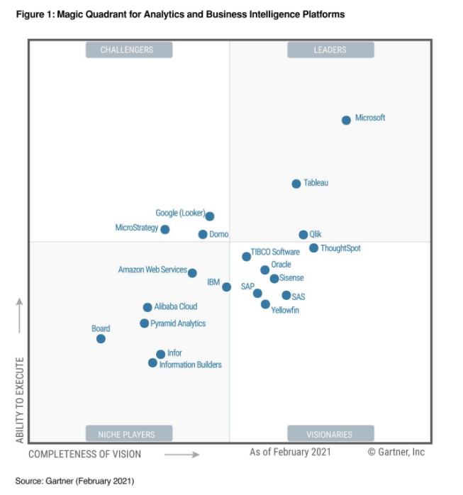
Power BI Desktop – why?
Connect~Transform~Visualize
Data -> Insight -> Action
Free to download and use
Vs. Power BI Service
Sharing .pbix file

Slide 8
Power BI Desktop - what?
Basic features
Get data
Data Profiling
Transform data
Data Modeling
Visualize data
Report Filters

Slide 9
Power BI Desktop - what?
Advanced features:
Hierarchy
Measures (DAX – Data Analysis Expressions)
Parameters
Power M query
Row level security
Tabbed reports
RBAC
….

Slide 10
Power BI Desktop – how?
Demo
Walk through landscape/features of
Power BI Desktop & Power Query Editor
Create 2 reports

Slide 11
Resources
Power BI Desktop – where?
Documentation : https://docs.microsoft.com/en-us/power-bi/
Microsoft events : https://events.microsoft.com/
Community : https://community.powerbi.com/
Certification : https://docs.microsoft.com/en-us/learn/certifications/exams/da-100
Other sites:
https://radacad.com/blog
https://www.sqlbi.com/

Slide 12
Thank you!
Coming and listening!
New Stars of Data
Best way to reach me : LinkedIn

